Slide 1

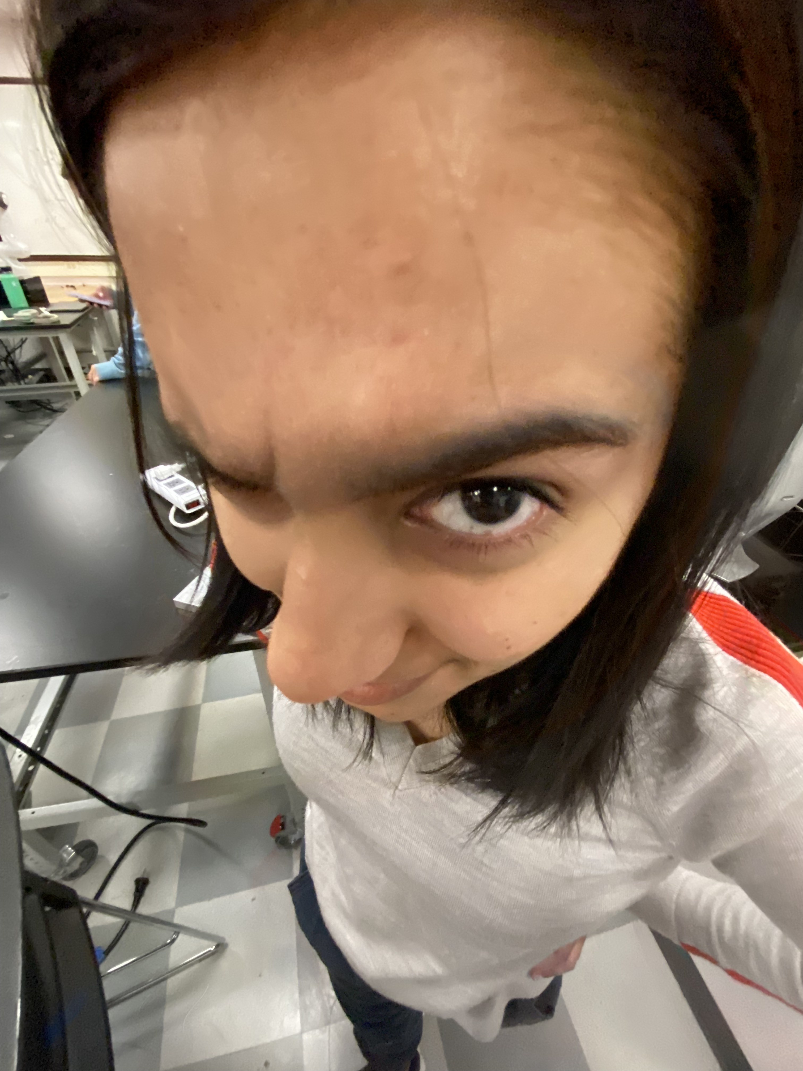
Final Portfolio
MEAM 247 2023C
Ashna Khemani
Figure 1: Ashna thinking very hard about drag over spheres in Lab 7
Figure 2: Ashna + friends featured on MEAM Instagram!

Slide 2
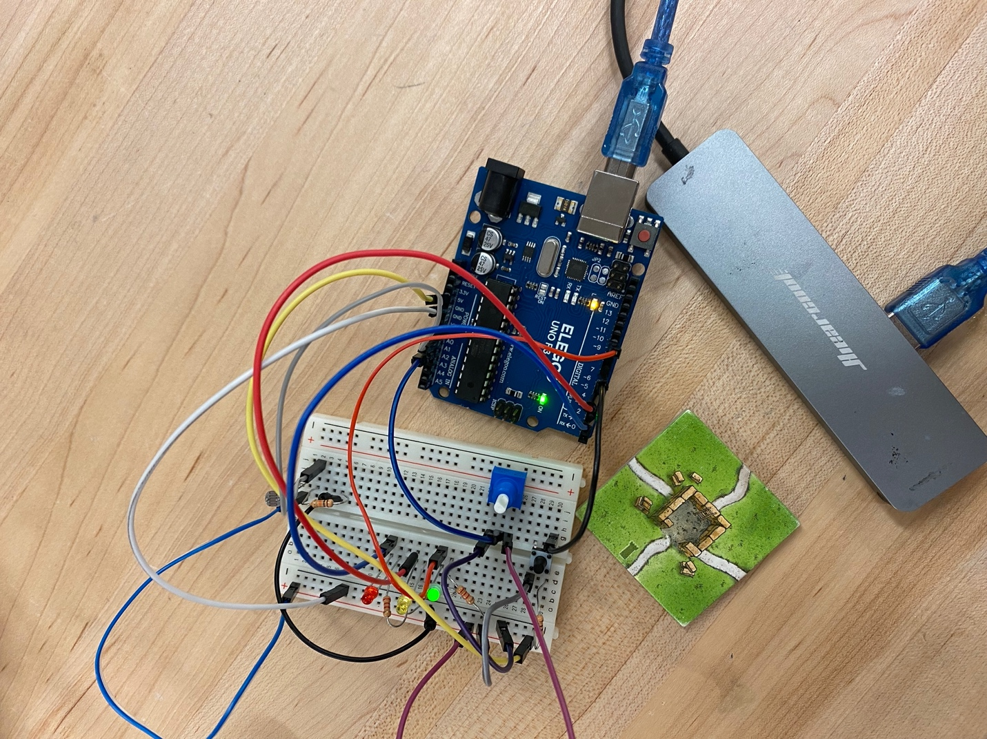
Lab1: Night Light (Photo & Code Screenshot)

Slide 3
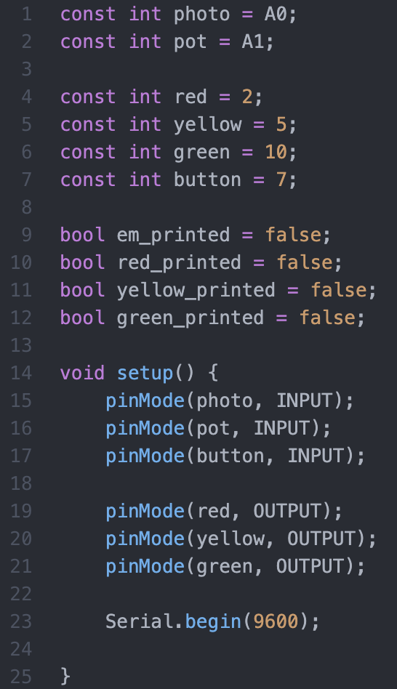
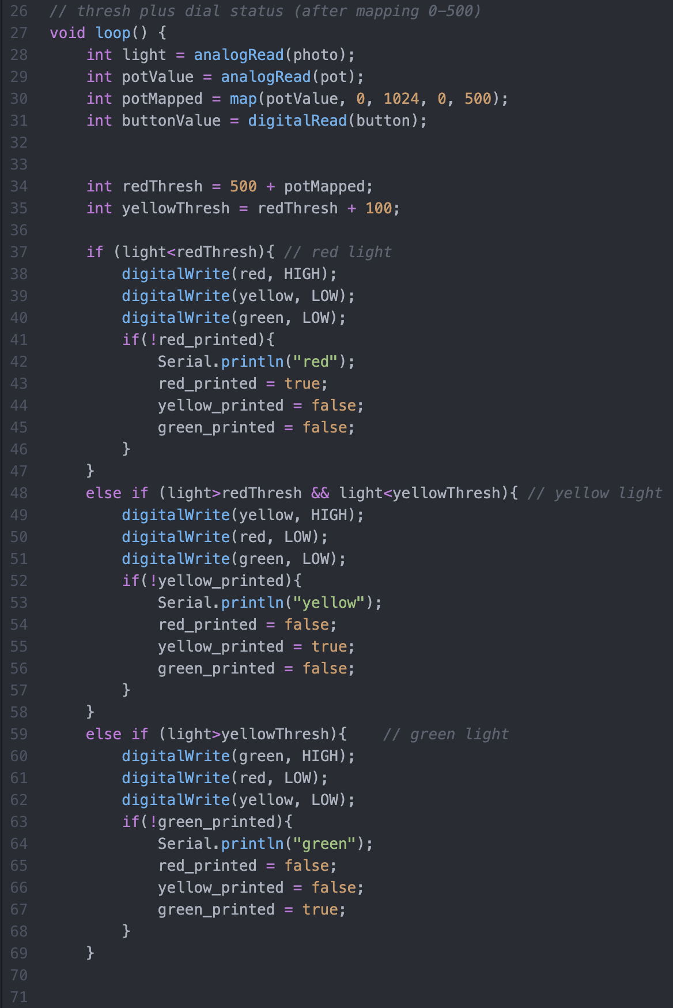
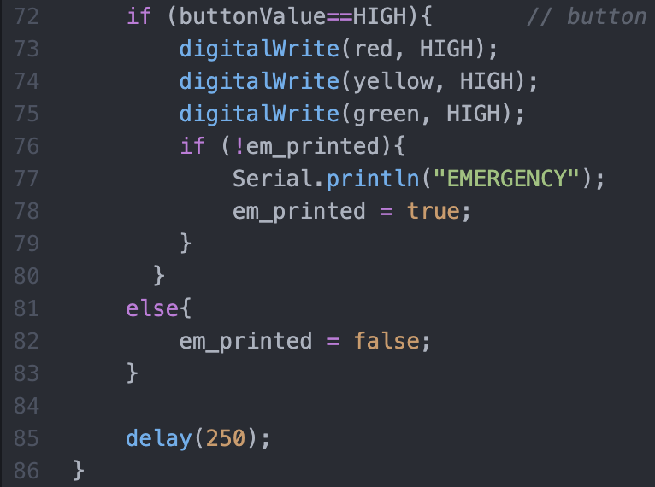
Lab1: Night Light (Photo & Code Screenshot)

Slide 4
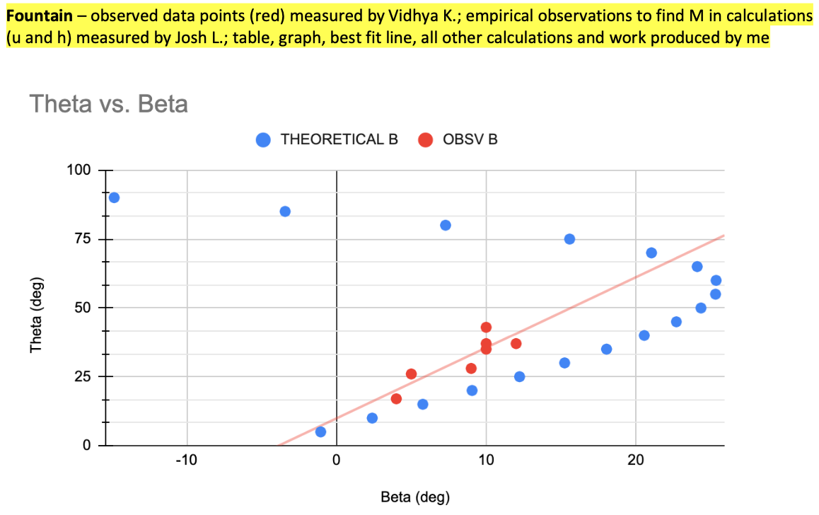
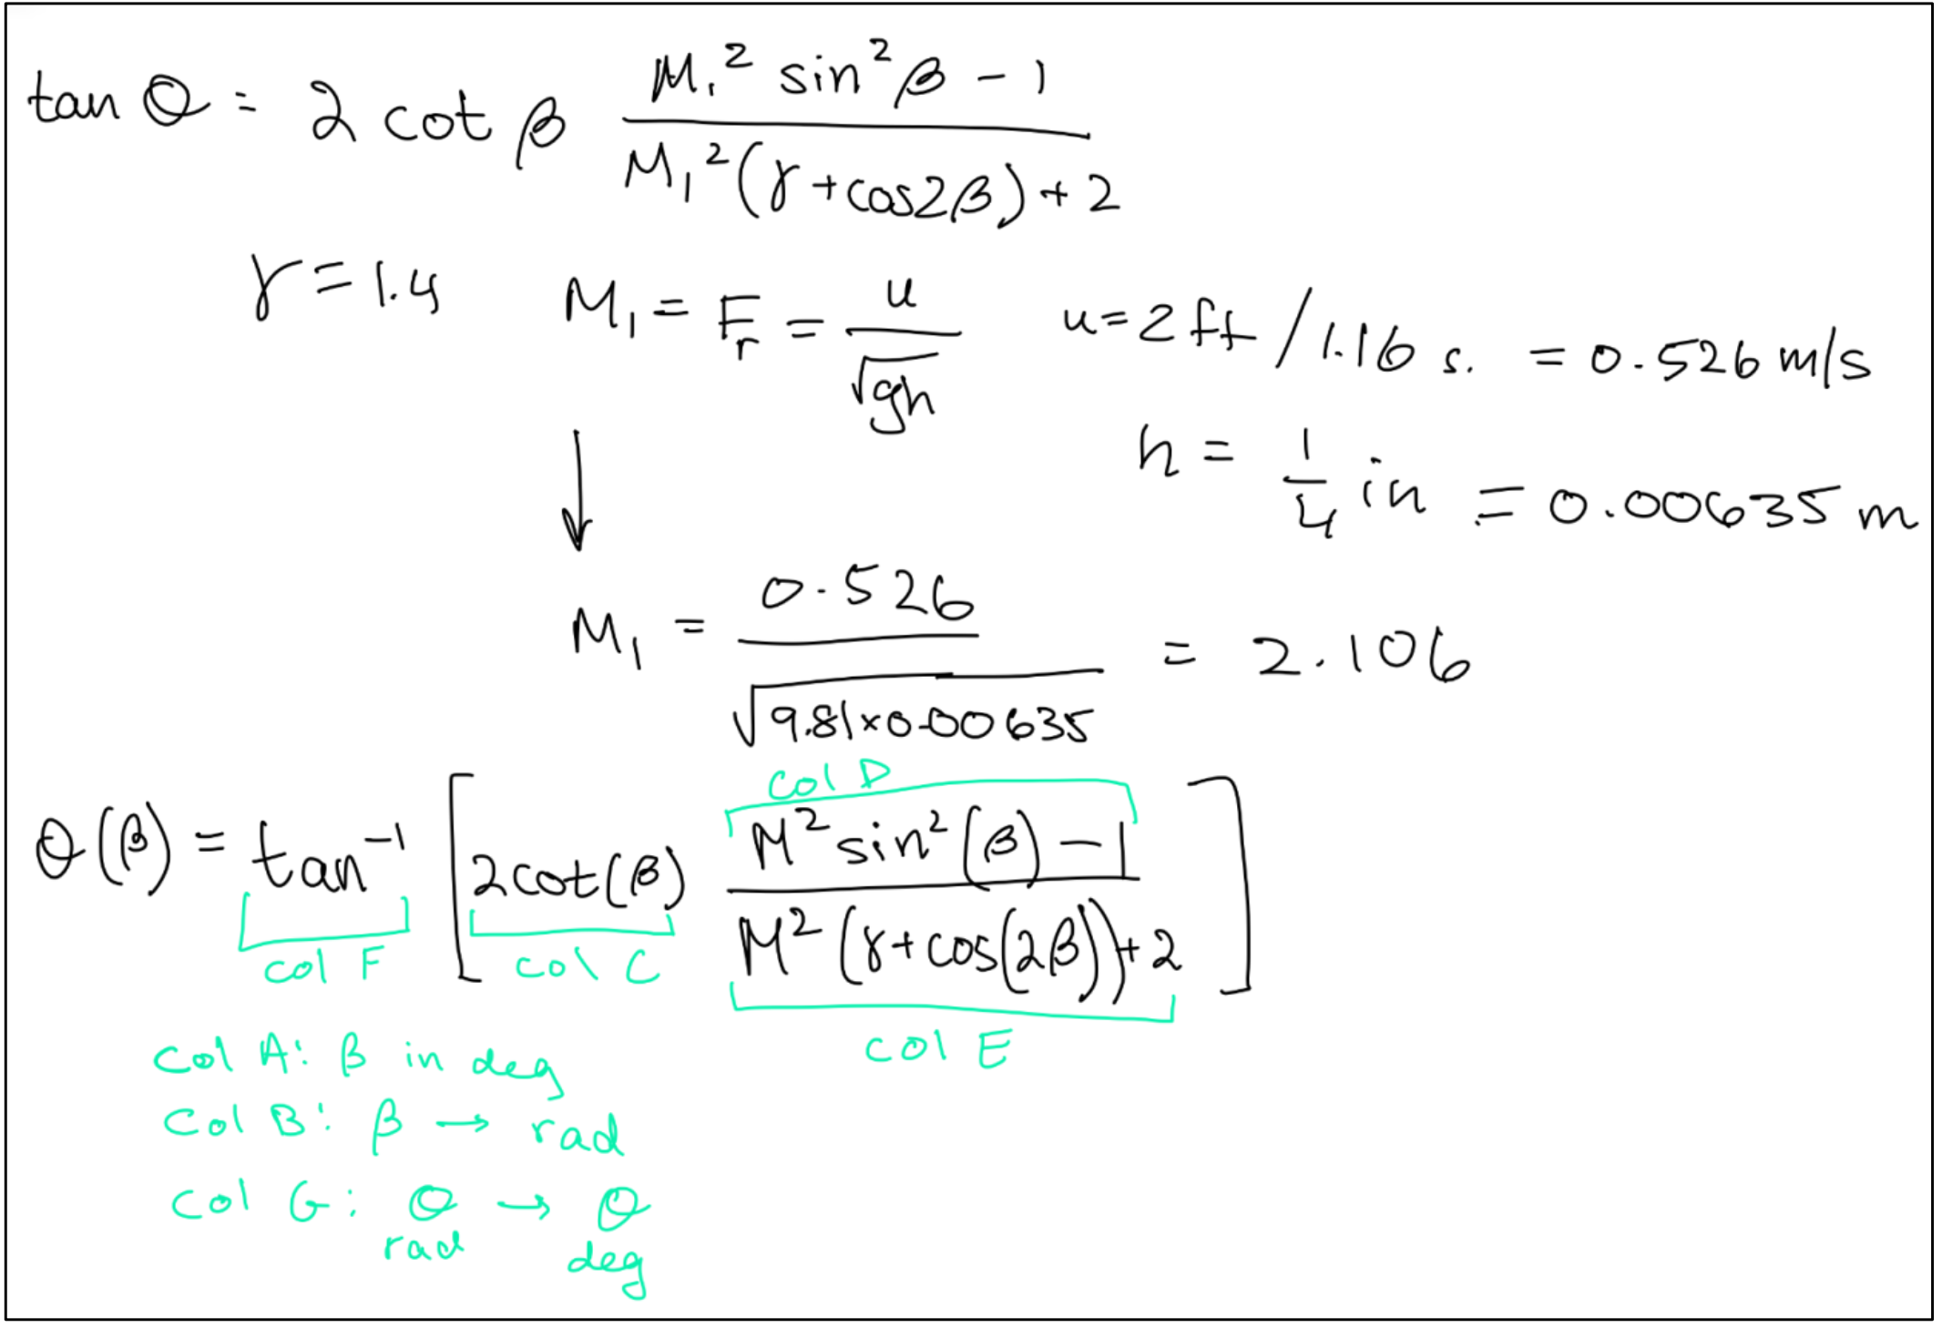
Lab2: Updated Fluid Graphs & Analysis

Slide 5
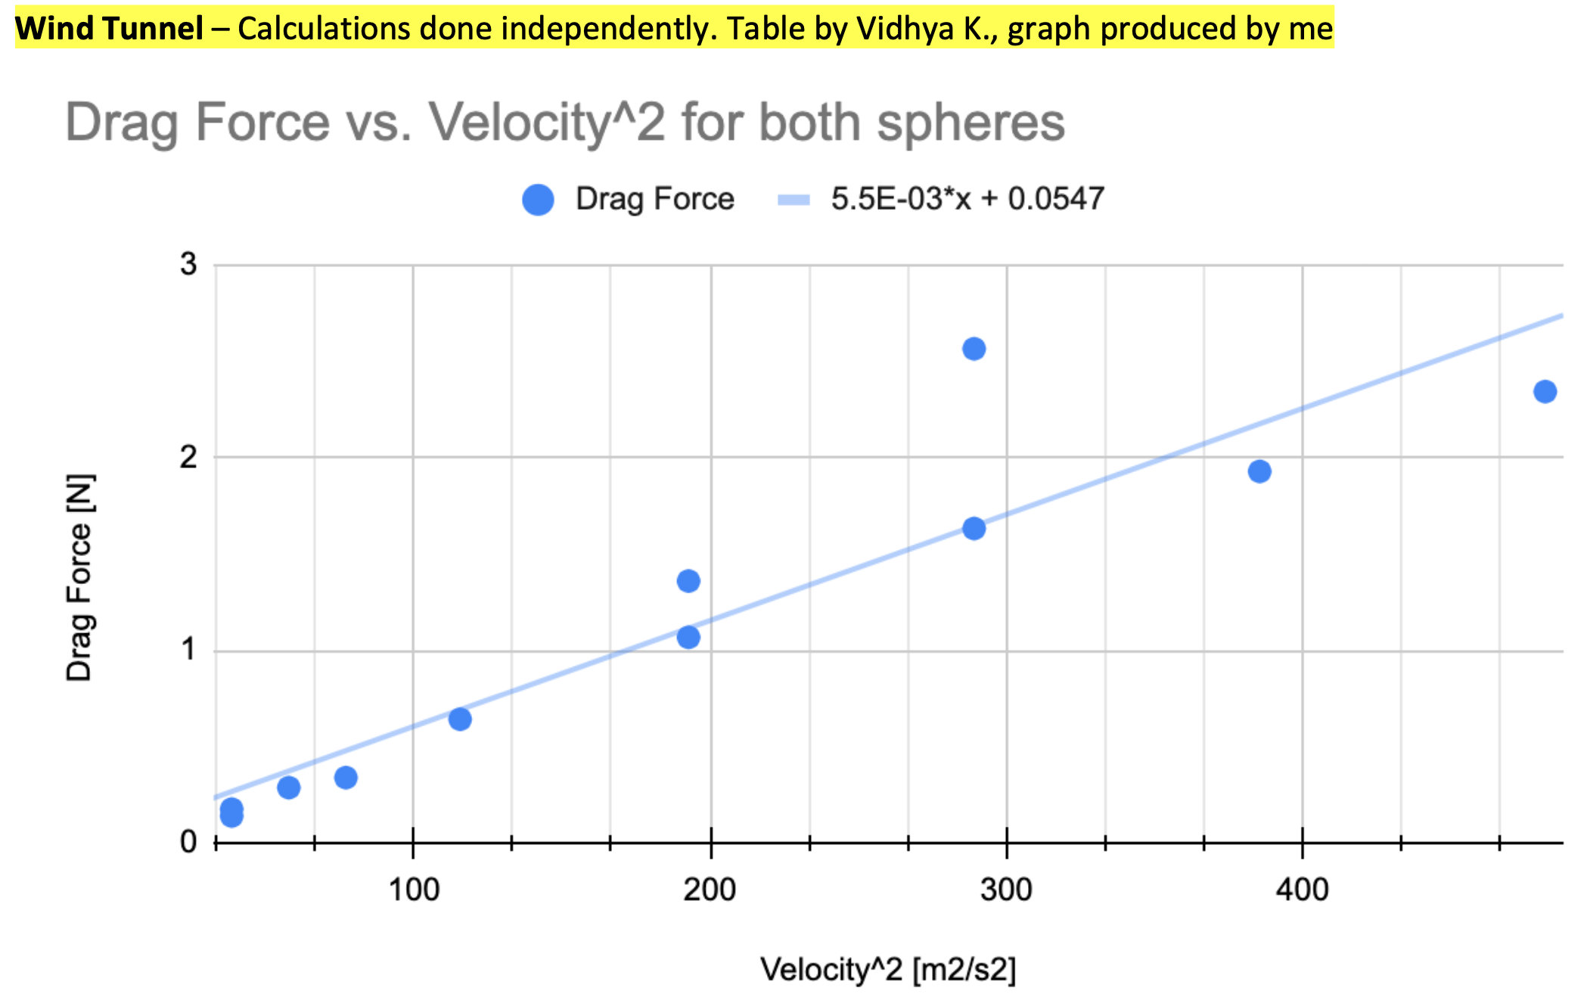
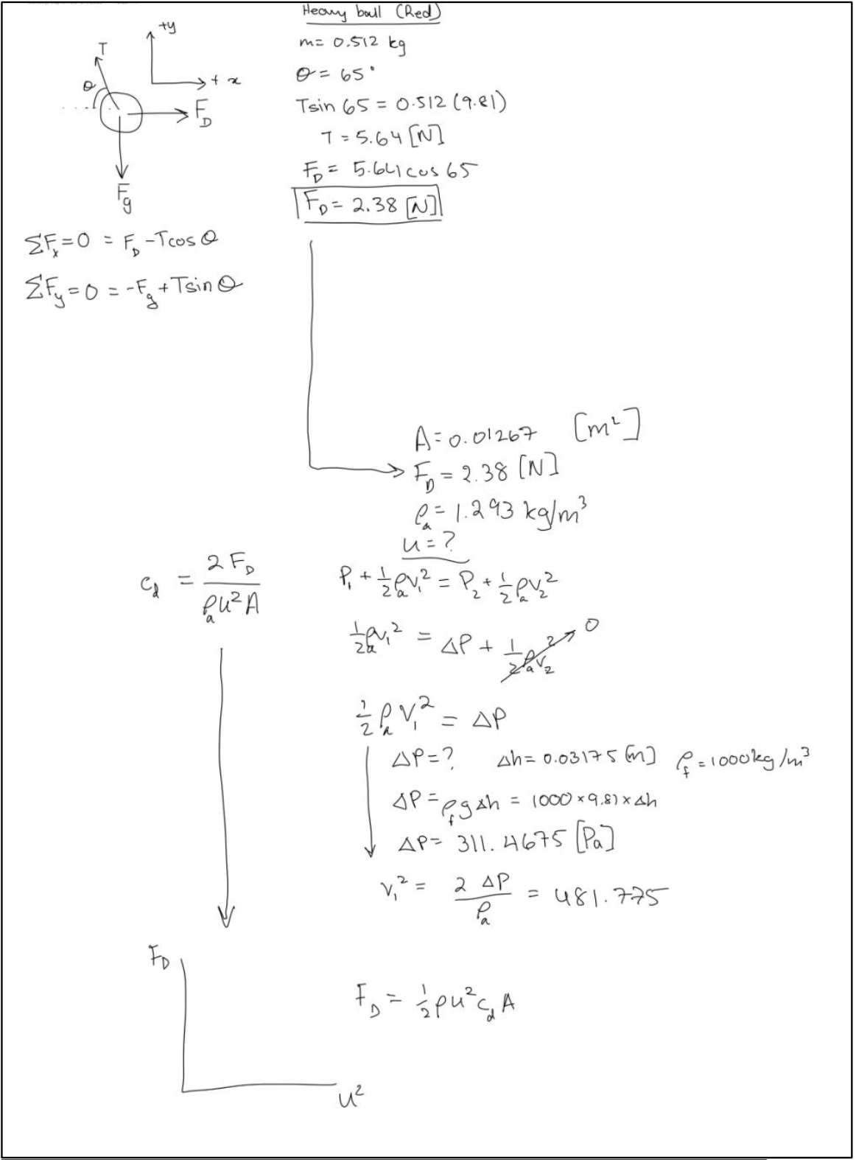
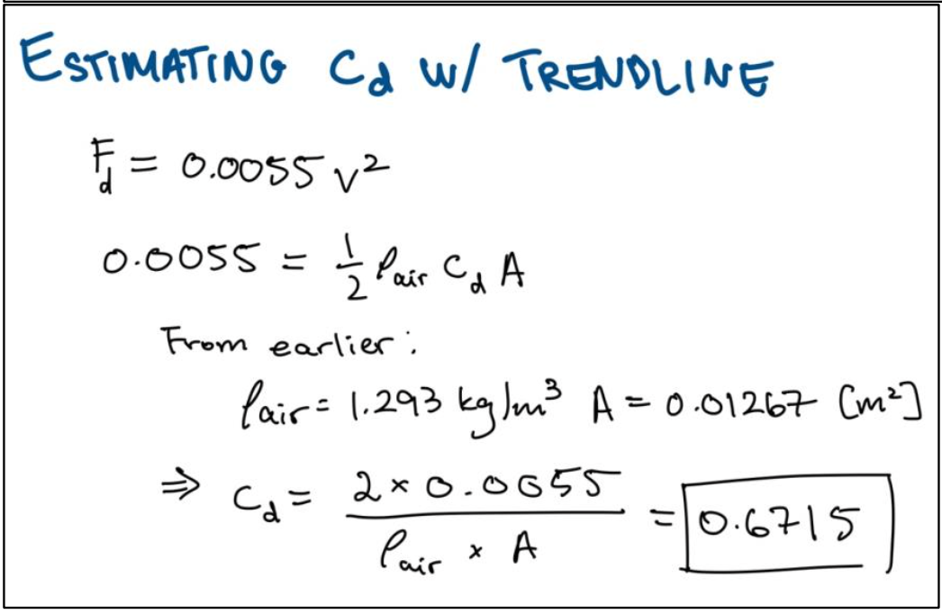
Lab2: Updated Fluid Graphs & Analysis

Slide 6
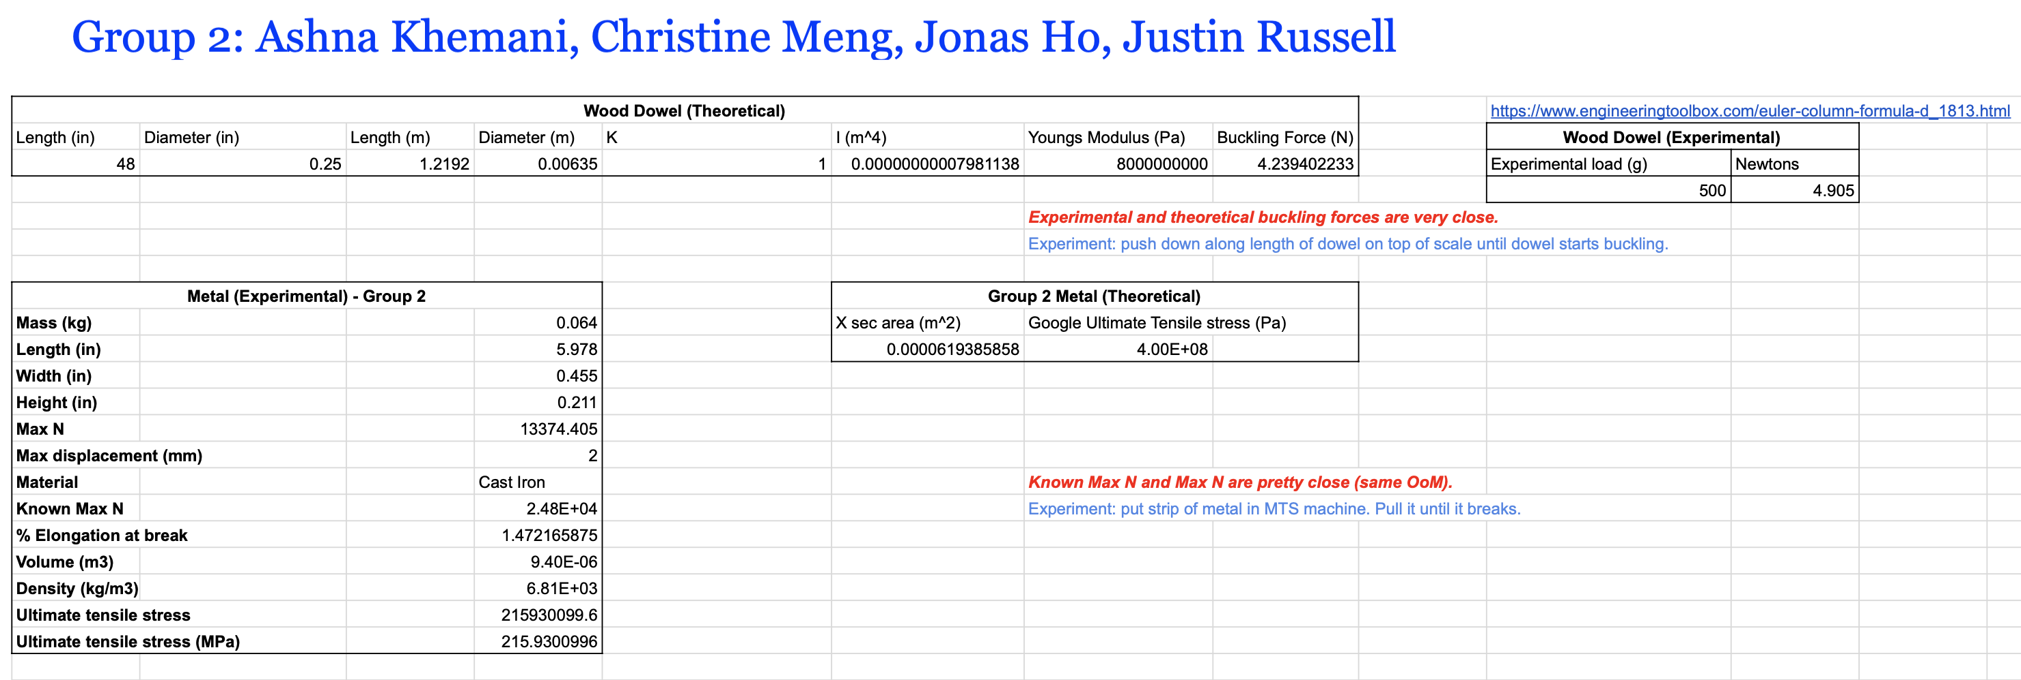
Lab3: Fracture & Buckling: Photos, Tables, Analysis

Slide 7
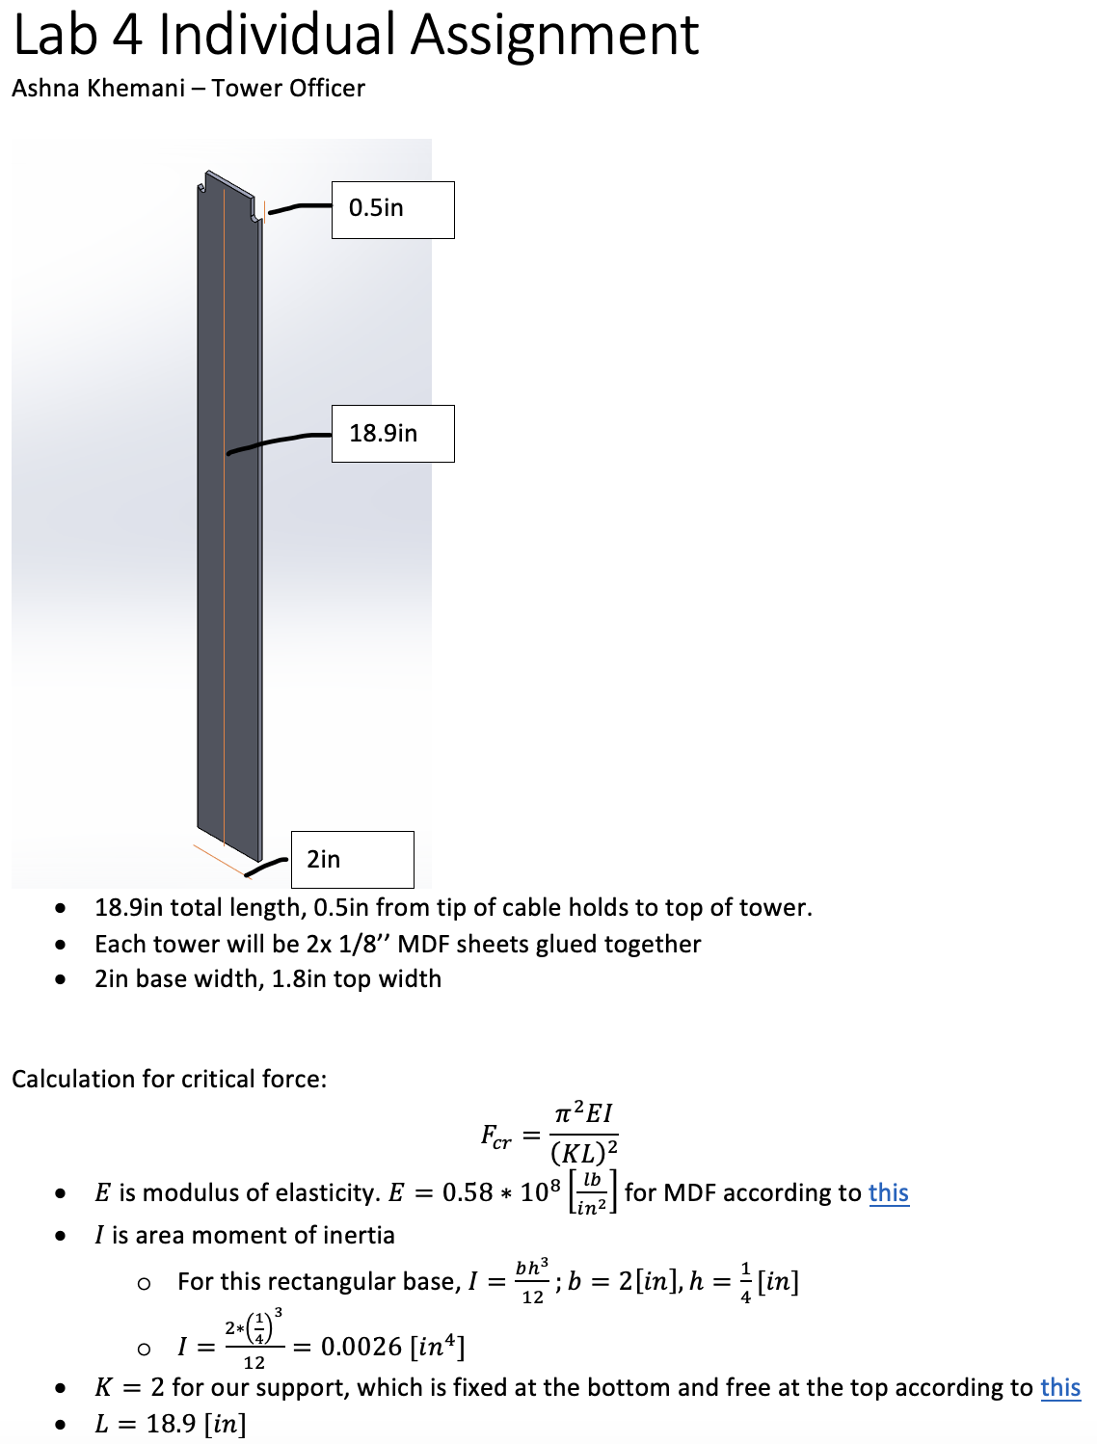
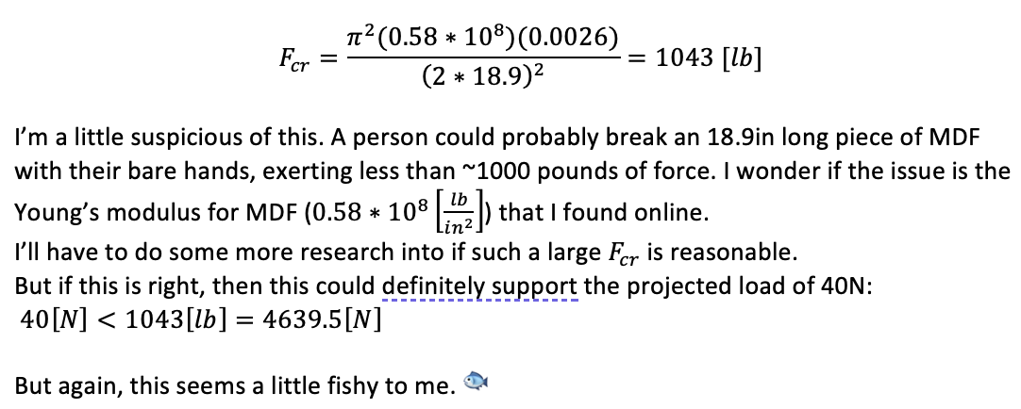
Lab4: Suspension Bridge Analysis & Test Photo

Slide 8
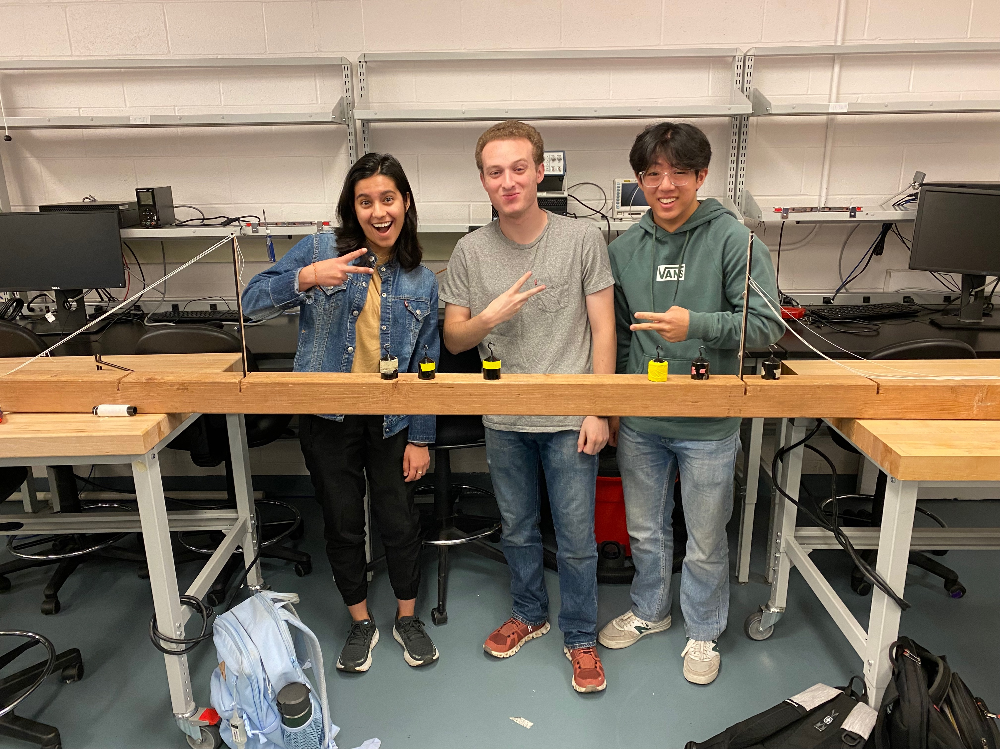
Lab4: Suspension Bridge Analysis & Test Photo
Almost worked but broke ☹
We overoptimized cost at the expense of performance. Our towers didn’t distribute tension over the cables evenly. So while our towers were intact, our cables snapped.
To improve, we’d rely less on the cable to hold everything together, and instead spend more money on the towers themselves. We might make a structure that has more depth along the length of the bridge, to avoid overbending while supporting more of the load.

Slide 9
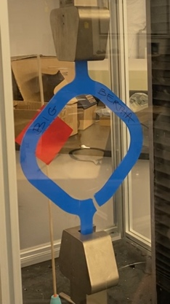
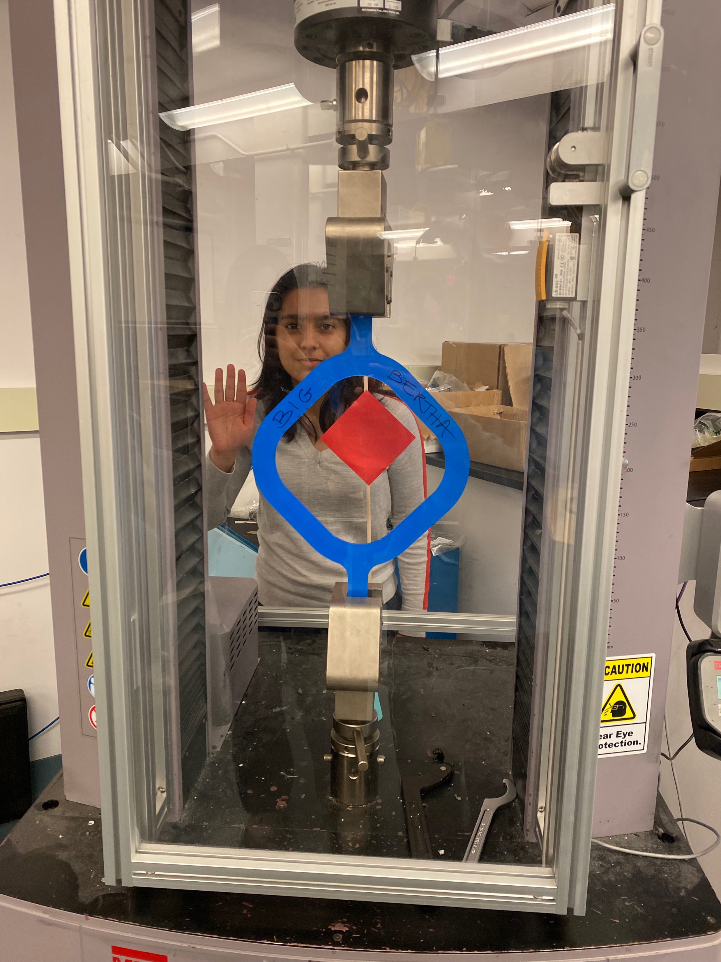
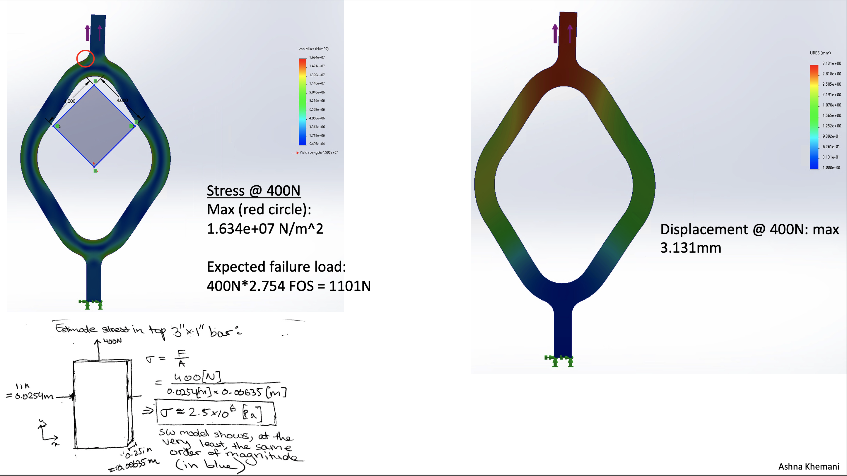
Lab5: Tension Strap Final FEA & Test Photo
A wistful goodbye to my beloved Big Bertha
~1000[N] later…

Slide 10
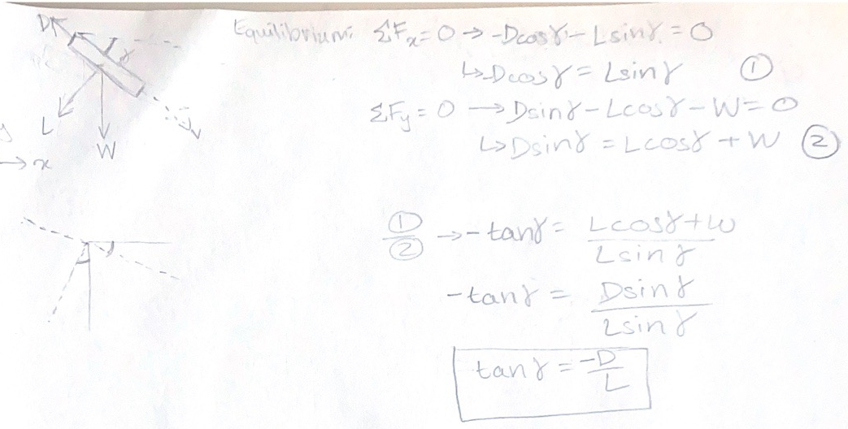
Lab6: Airplane Flight Test Media & Graph
FBD + equation

Slide 11
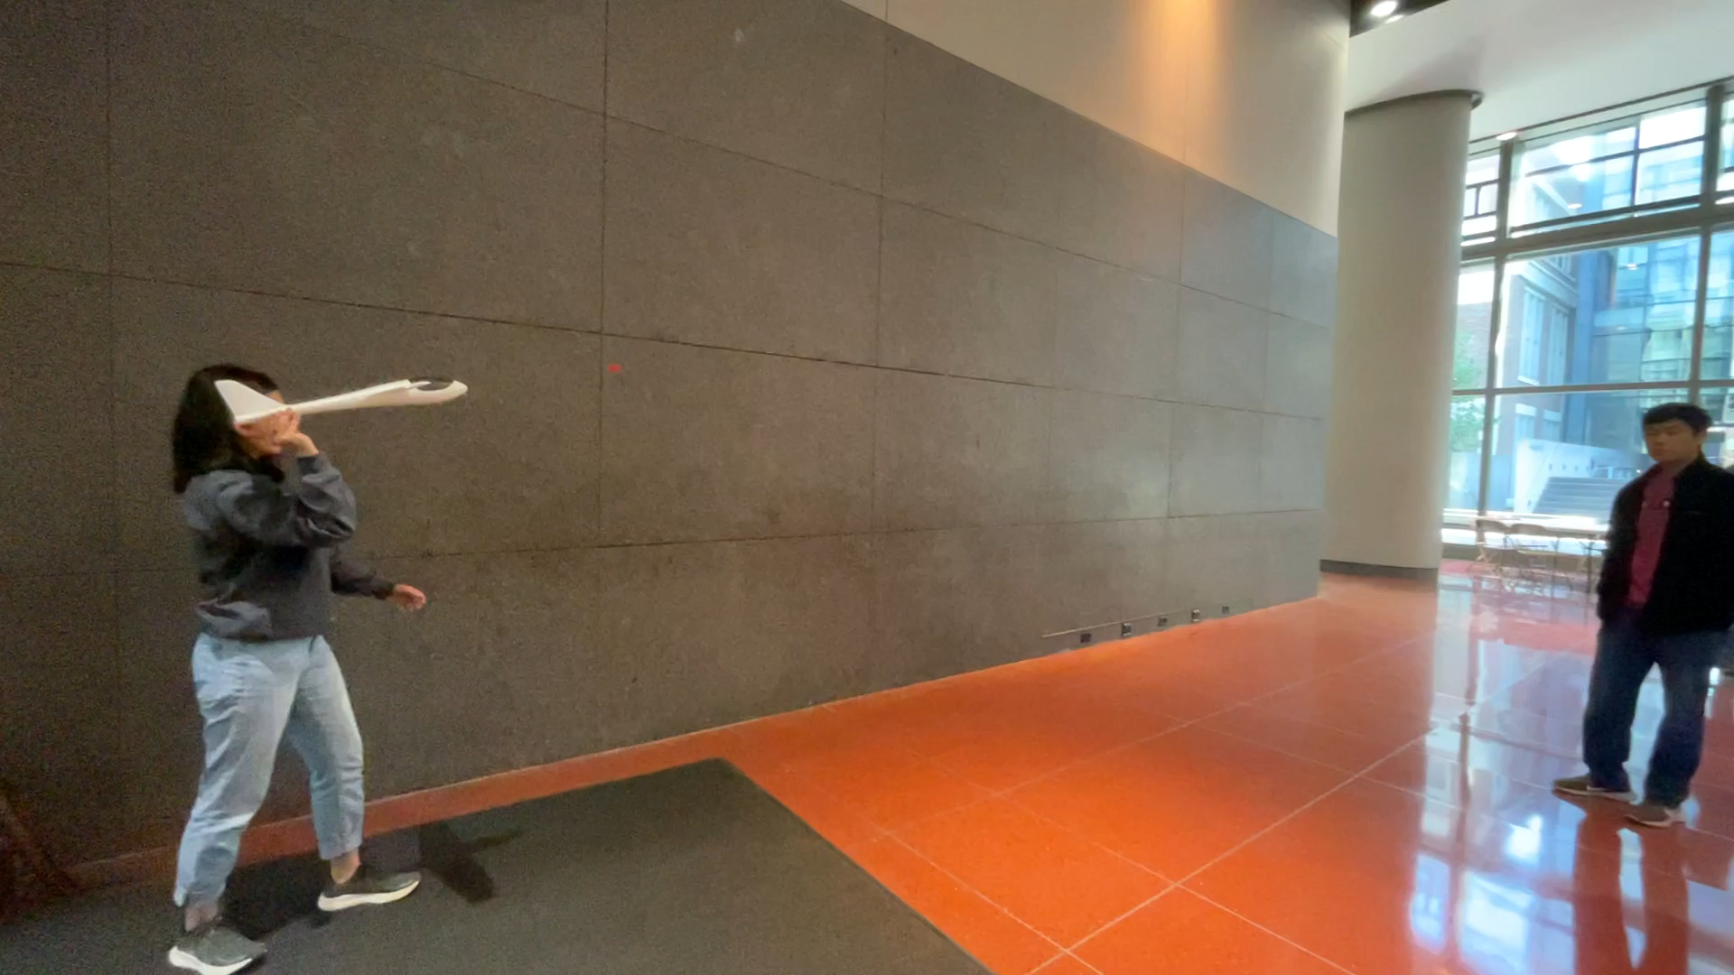
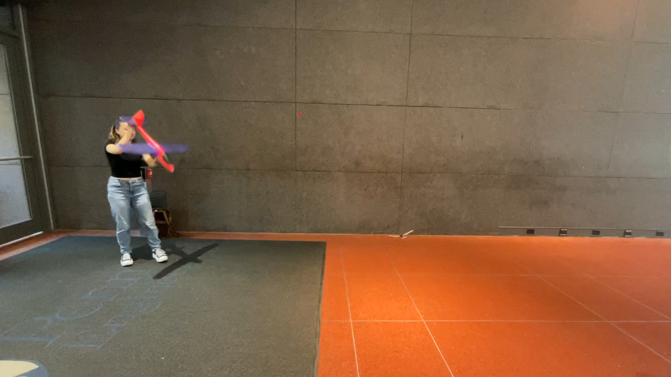
Lab6: Airplane Flight Test Media & Graph
Flight Videos (with Kayla)

Slide 12
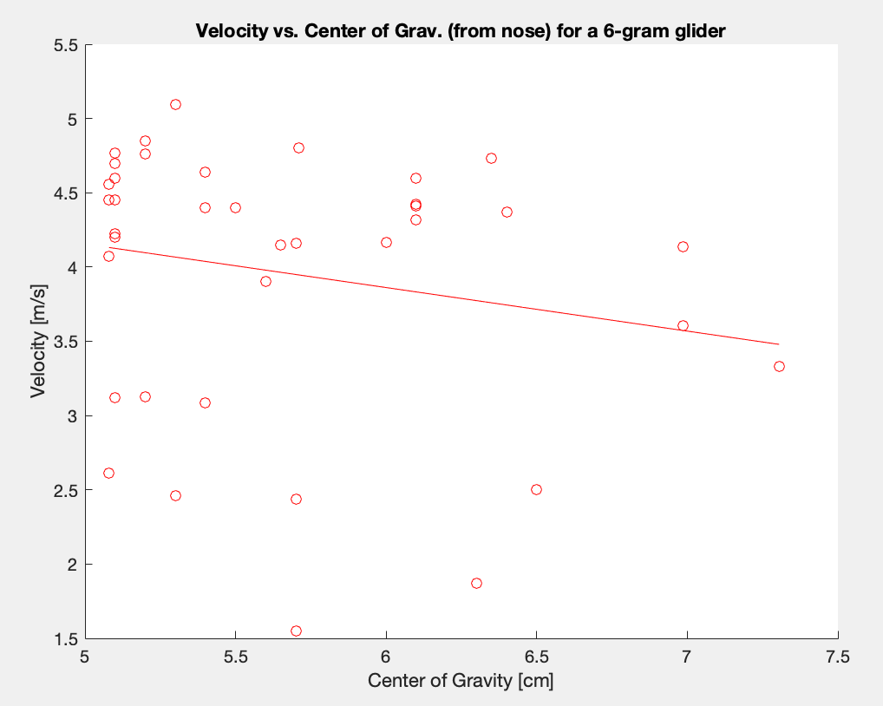
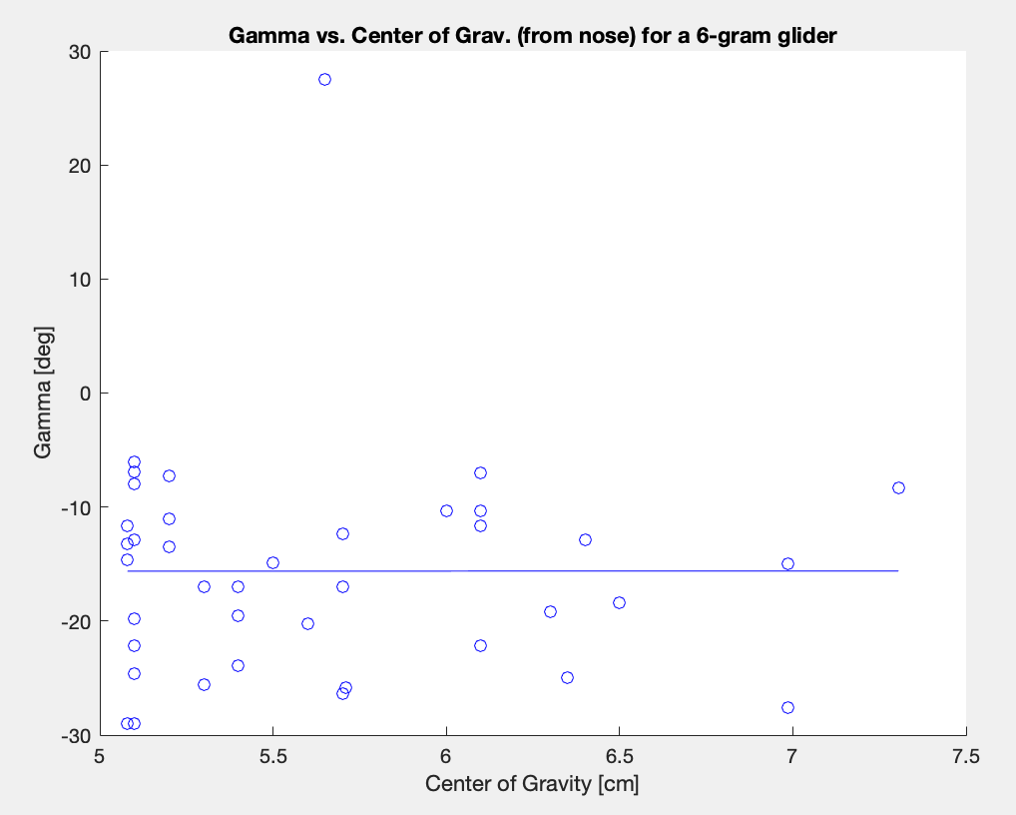
Lab6: Airplane Flight Test Media & Graph
Graphs (from 10:15 section class data)
Hard to find patterns; noisy data ☹
Would need more stable flight throws.

Slide 13
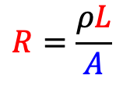
Lab7: Load Cell Explanation & Sphere Drag Graph
Load cell explanation
Load cell: bend beam → elongates and reduces cross section of the squiggly wire across the deforming surface
$$R=\frac{ρL}{A}$$
Measure the change in resistance (the change in voltage drop) across the wire → can give you an idea of how much the wire deformed → how much the beam bent

Slide 14
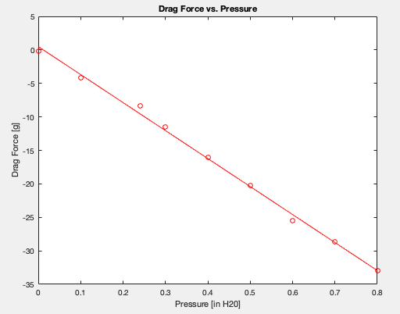
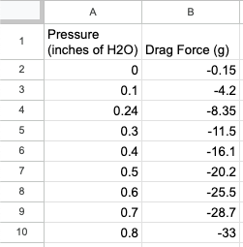
Lab7: Load Cell Explanation & Sphere Drag Graph
Sphere Drag Graph (data from 10:15 section)

Slide 15
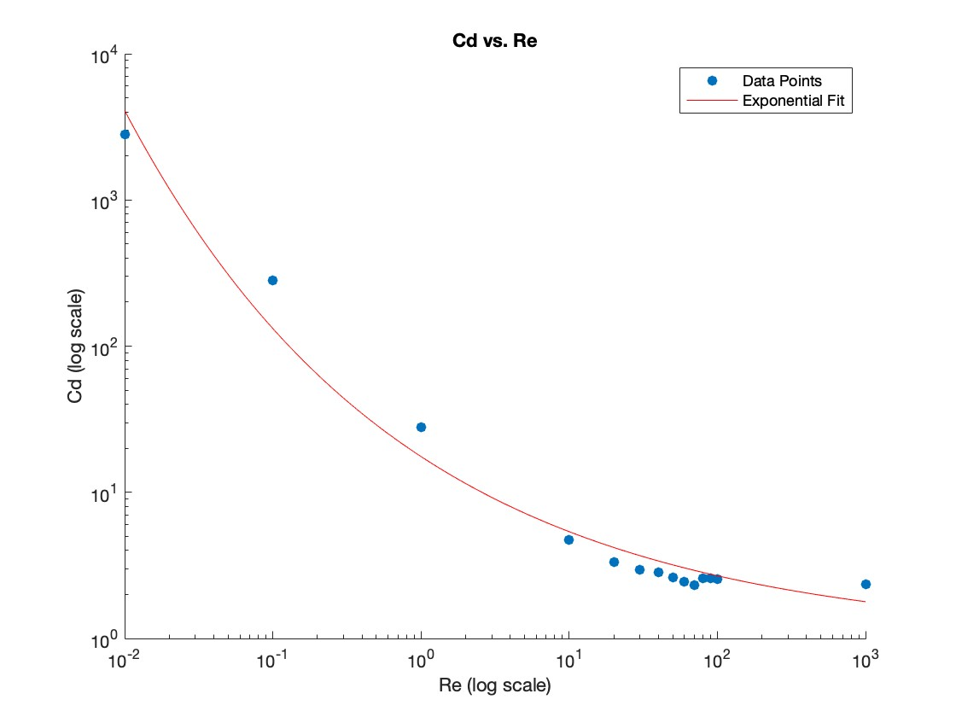
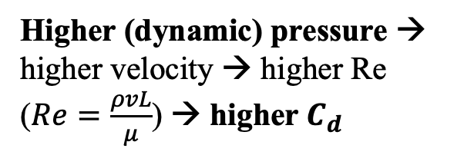
Lab7: Load Cell Explanation & Sphere Drag Graph
Makes sense, compared to MEAM 2020 project (view here)
Higher (dynamic) pressure → higher velocity → higher Re ($Re=\frac{ρvL}{μ}$) → higher $C_{d}$

Slide 16
Looking Forward in Learning & Life
Stuff I’m Excited to Learn Next
How and why stuff flies
Maybe more about aerodynamics? Fluids? ???
Data science, machine learning, AI… *insert more Silicon Valley-esque buzzwords, but genuinely*
How To Robot and Why To Robot
Humanitarian causes/disaster relief
Safety in manufacturing, human + robot collaboration
Where I See Myself in 5 Years
If money wasn’t an issue: teaching high school engineering/math/sci., coaching robotics teams, generally helping kids find a love for hands-on engineering
Maybe: MSE in Robotics? MBA? Both? Who knows.
Hopefully: making robots and systems that are actually useful (space rovers, drones, legged bots). Doing hands-on work.
But it would be cool to be a leader/specialist in a company with fresh and funky ideas…
Will it work? Who knows!
Will it be cool? Yeah!
Will it inspire others to get on board? I hope so!

Slide 17
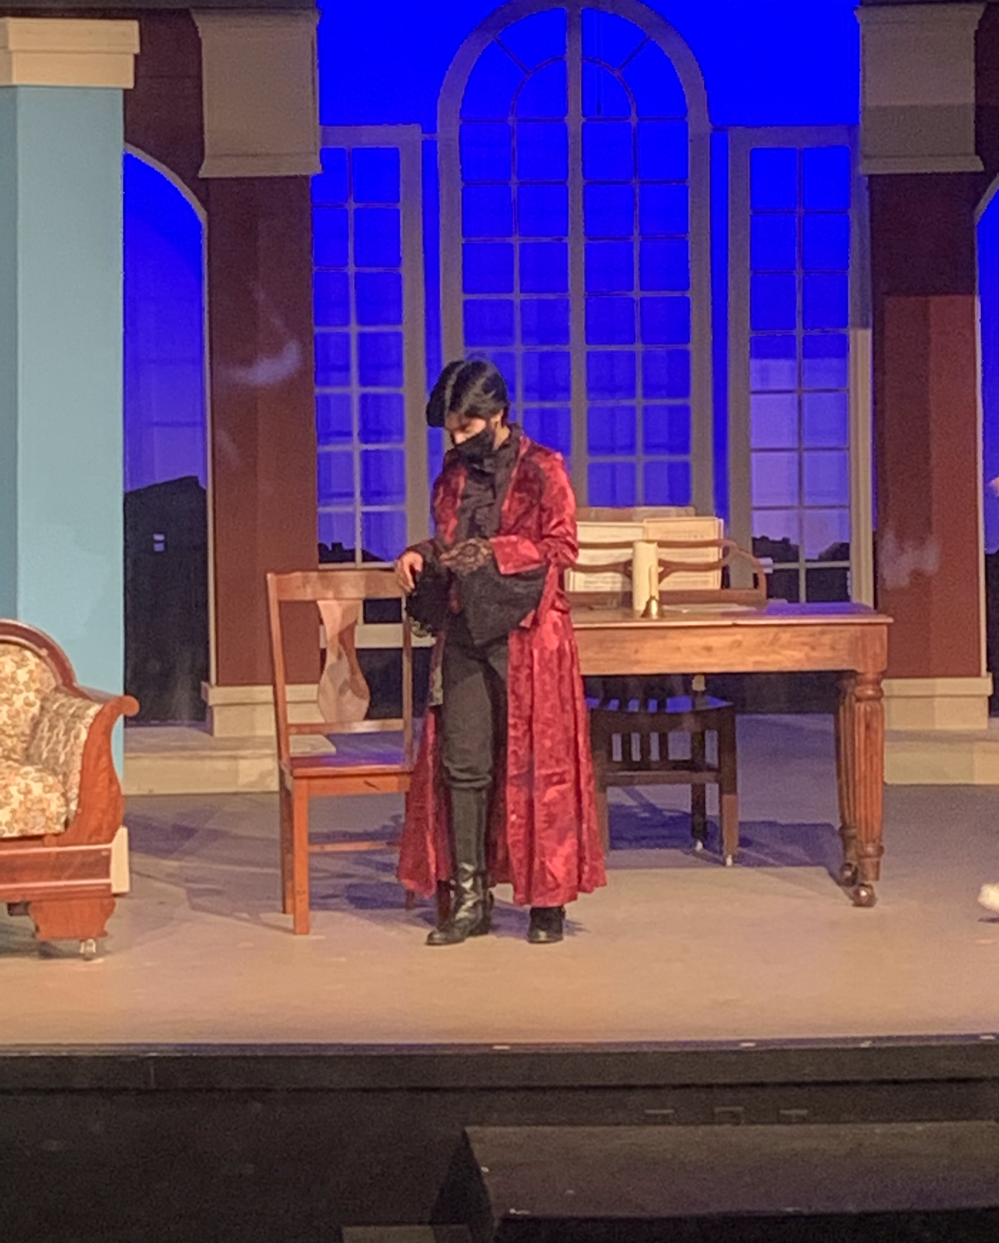
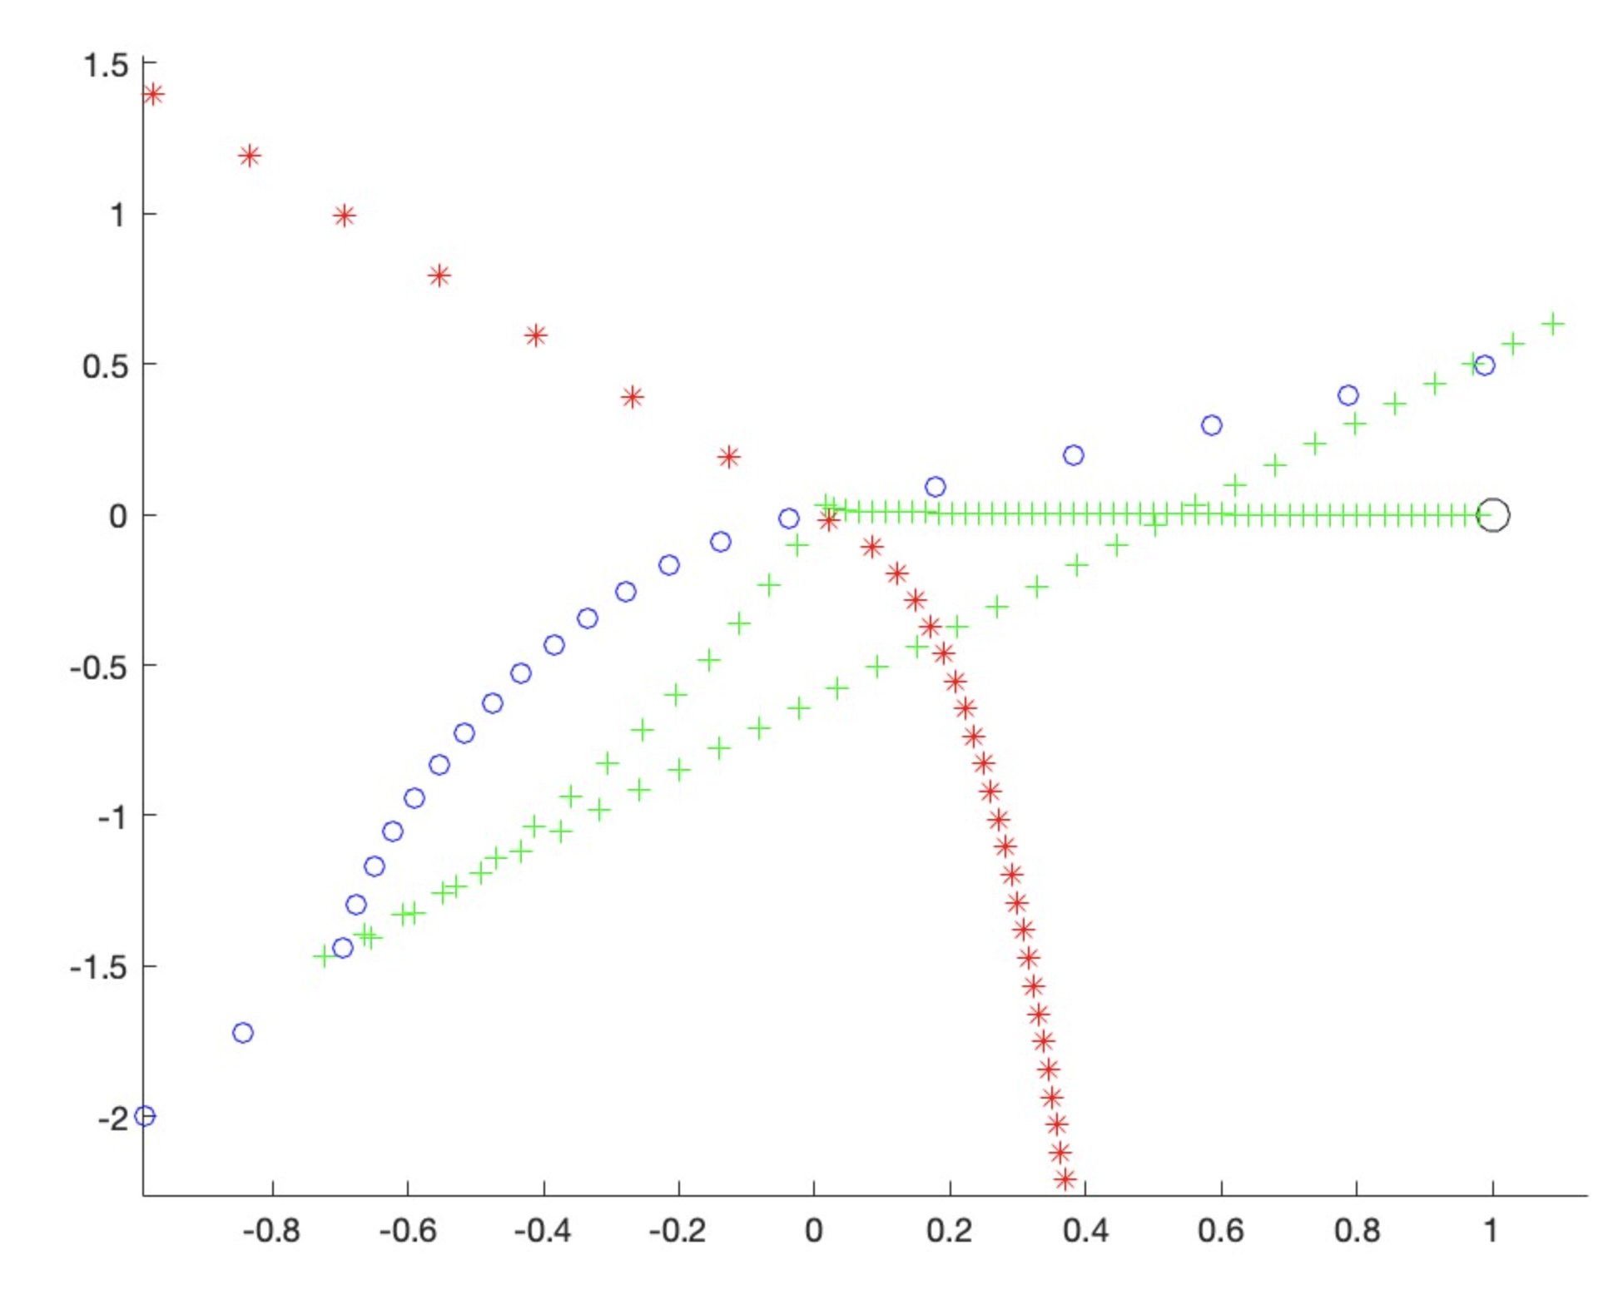
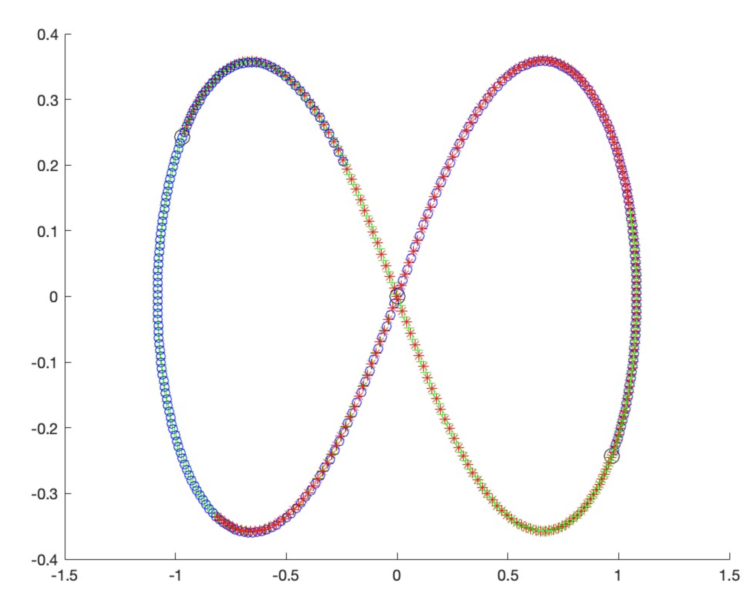
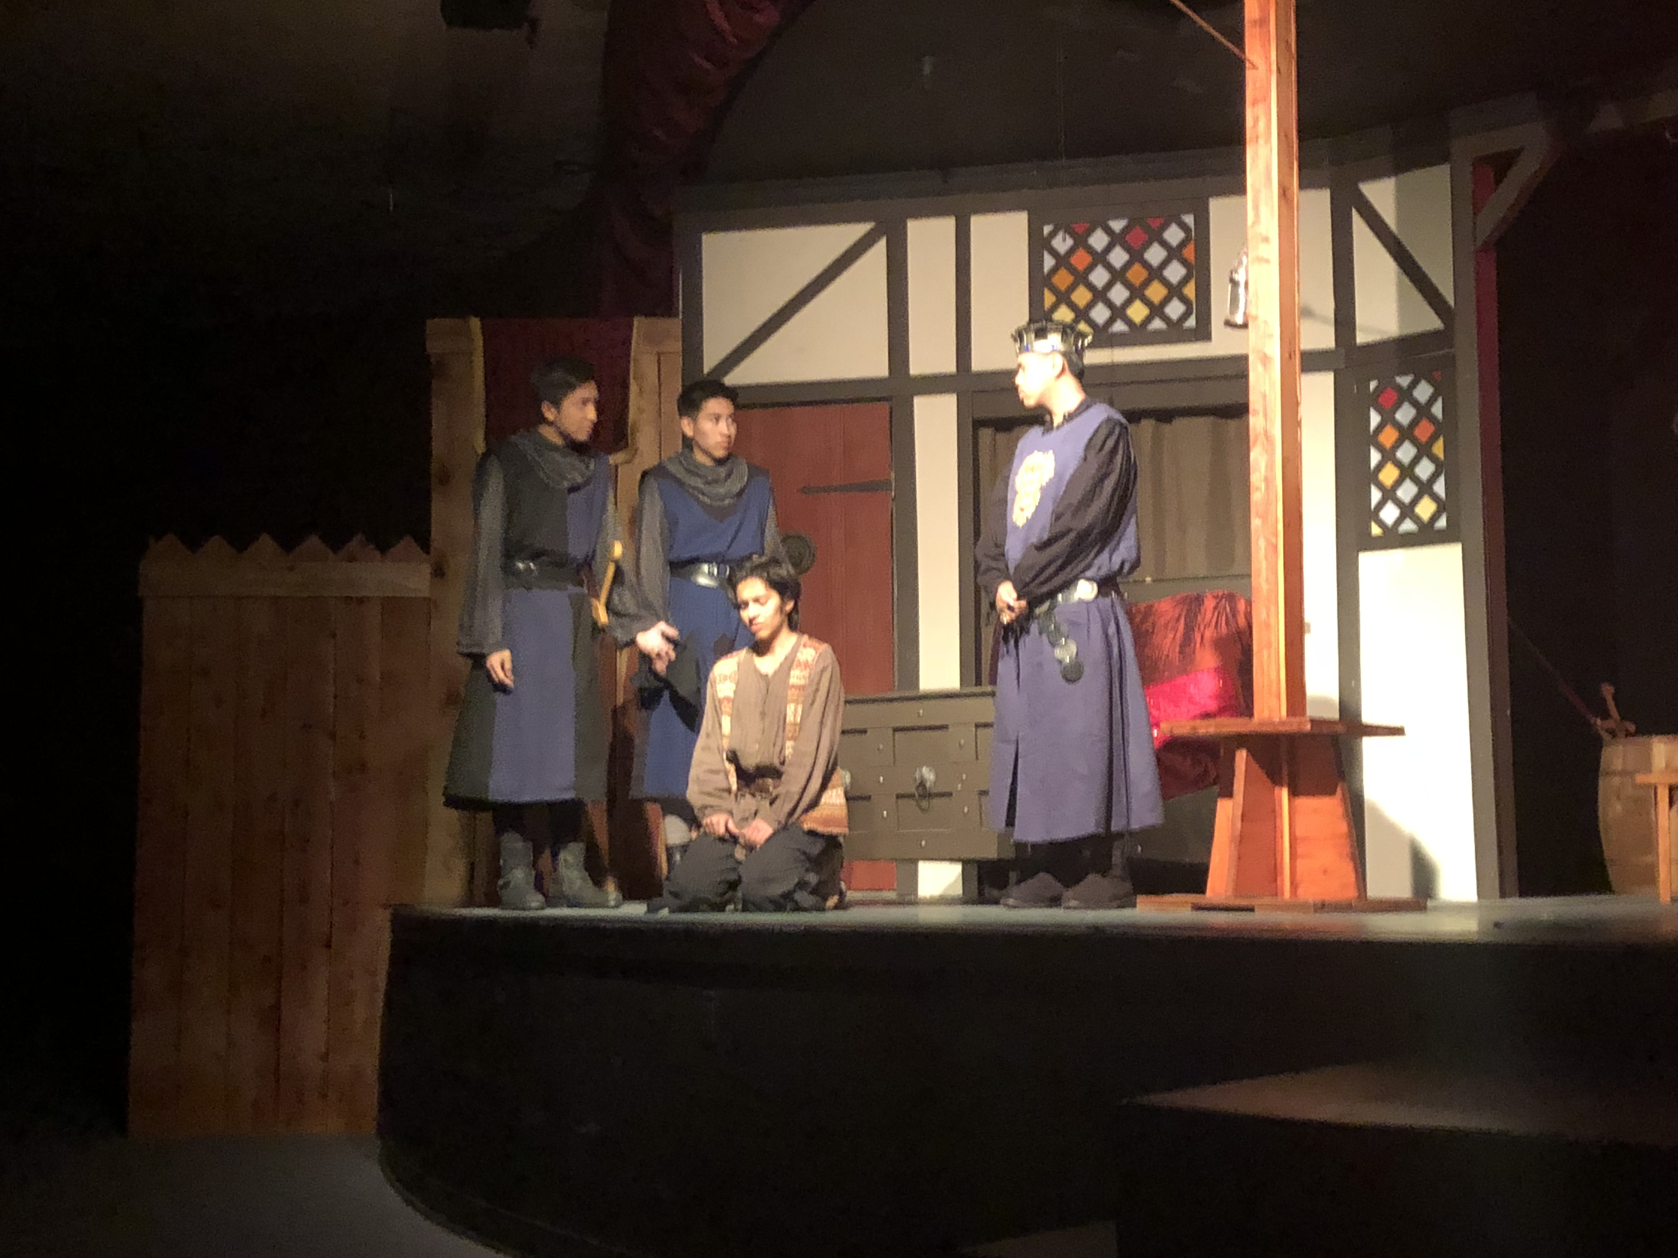
Interesting Stuff
Theater = fun
Three-Body Problem is literal chaos but kinda cool

